Slide 1
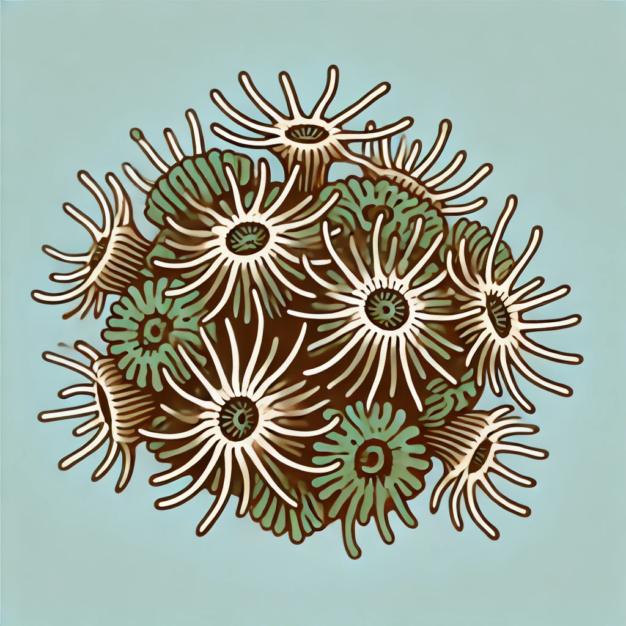

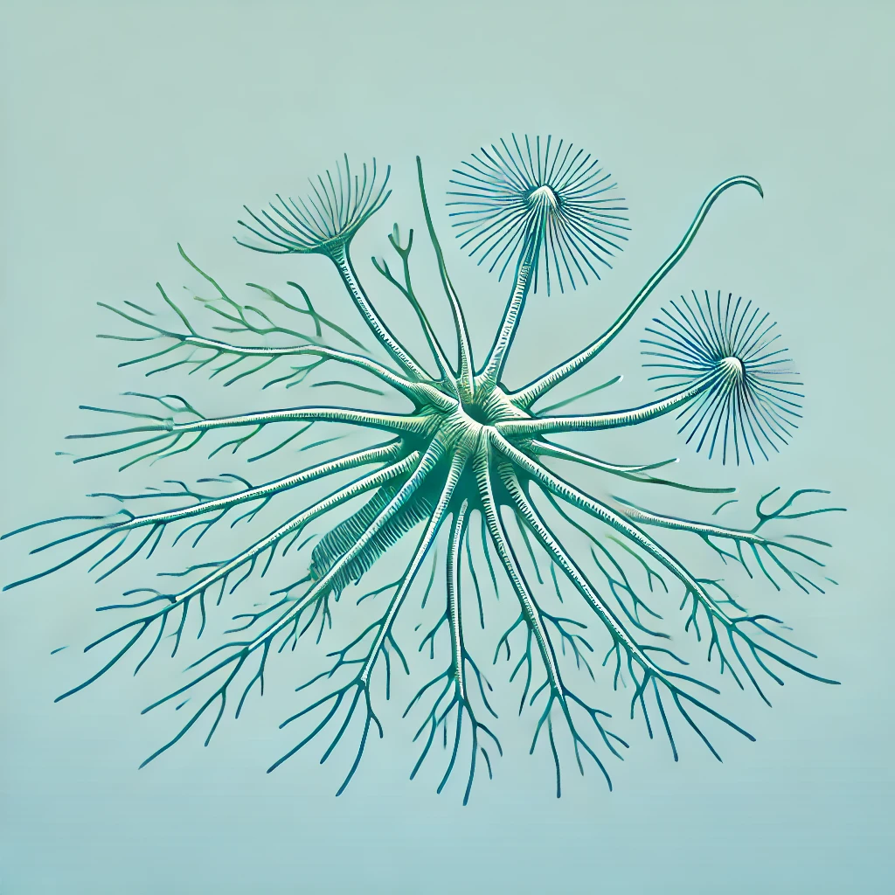
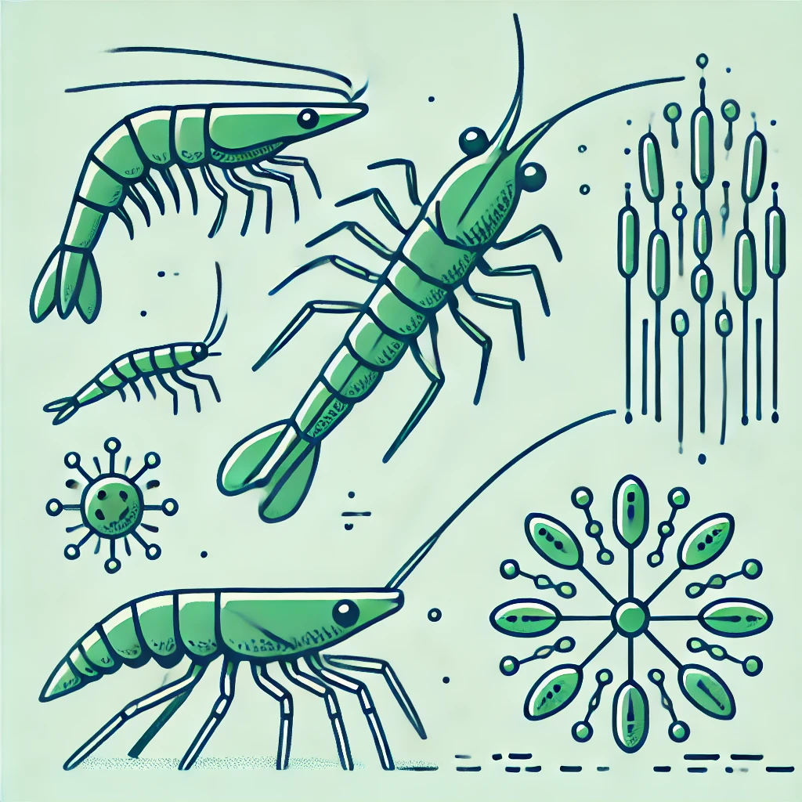
Epibiont removed from seaweed blade
eDNA filtered from farm seawater
Zooplankton, phytoplankton, blades with epibionts sampled
Salinity, temperature, PAR, nutrients, chlorophyll data recorded
DNA extracted from epibiont
DNA extracted
Microscopic visual survey
PCR amplification (COI) to isolate epibiont DNA
DNA amplified and quantified: ddPCR / qPCR using tailored primers
Sanger Sequencing to show region base order for each species’ genome
Predictive Casual model
Identify regions with high copy number for each species
Determine biofouling risk based on parametrised sensor data
Tailor primers that amplify identified regions
Extend growing season to maximum potential
Reduce loss from biofouling
Increase farm yield

